Slide 1
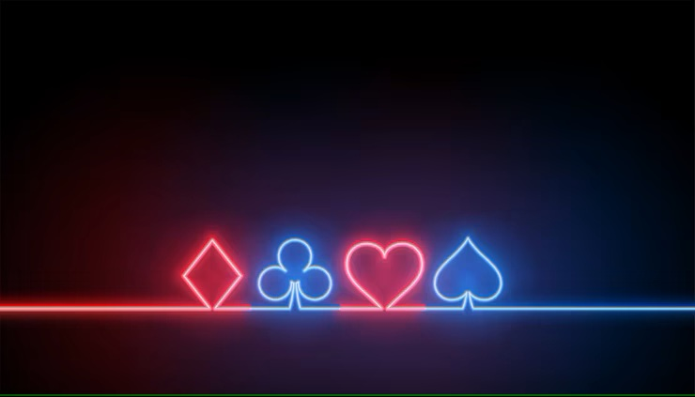
BLACKJACK
Group 2

Slide 2
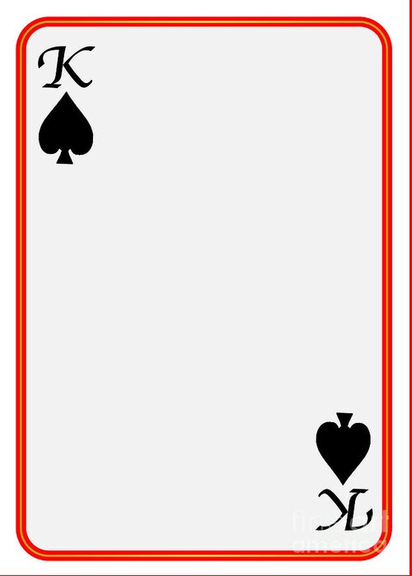
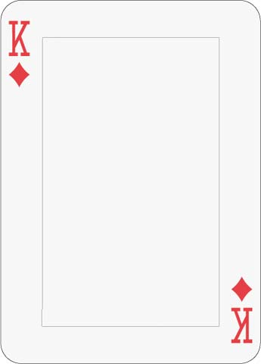
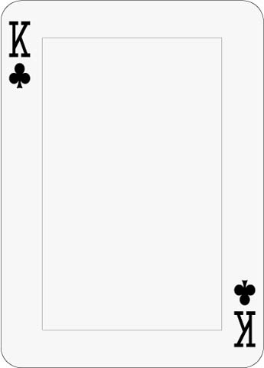
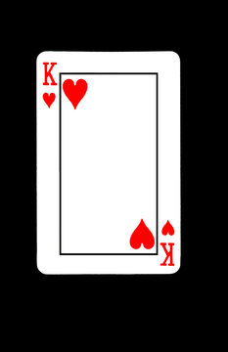


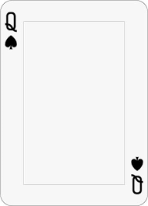
Cristian Gonzales
Armand Tirado
Brandon Wall
Kenny Yu
Cristian Gonzales
Mahlet Bekele

Slide 3
What we were able to accomplish
Users are able to login as either a dealer or player
Dealers can access the table lobby and then create a table
Players can access the table lobby, but can’t a join table until a dealer is present
Once in a table, players can request a hit from the dealer
The dealer is able to give a card to users when they request a hit
If a player gets a hand value of 21 they are congratulated
If a player gets a hand value over 21, they lose and are scolded
Dealers are also able to play
Dealers are able to close tables, which brings both the players and the dealer back to the table lobby

Slide 4
Things we didn’t anticipate
During our design phase, we did not take in to account all the proper messages that would need to be made between the Client and Server
Added different message types and ways to handle them
Handling sending messages out to multiple client from dealer to player
Lots of message sending between player to server , server to dealer, then dealer back to player
Updating the GUI with real-time game properties proved to be a harder challenge.
A solution that we thought of was to have an update method for the panels that we could call when game property changes were made.

Slide 5
Things we didn’t anticipate
Turn base aspect of the game was going to be hard.
We managed to get some aspects working, like dealing, but “turns” didn’t pan out.
Creating the animation for all the cards shuffling.
Decided not to create the animation or display all 52 cards in the deck, much less all 3 decks in a shoe.
Timer was too hard to implement, such as displaying it and having it countdown in real time.
Decided not to use the timer.

Slide 6
Uncompleted goals
Money management
Currently the game only displays a players balance while connected to a table
Game turn management
Not allowing players to request a hit when it isn’t their turn
Ending a players turn when they select to stay
Making sure the dealer is the last person to take their turn
Timing a players turn to last 30 seconds

Slide 7
Things we would do differently
Focus on Server, Client, and Message first, then focusing on the GUI
Start building a functional simple system and then add on
Have a better fleshed out and thorough design
Better time management and organization

Slide 8
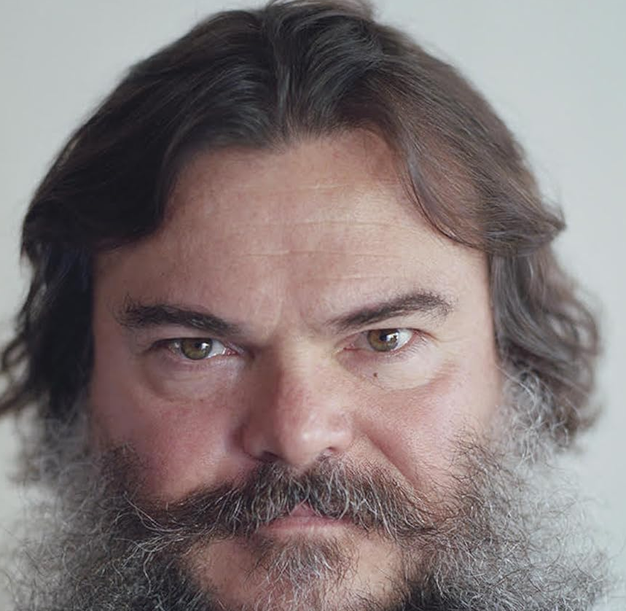
DEMO
w

Slide 9

Thank You
w

